Slide 1

Automatic Text Summarization
Group 5
Final Results

Slide 2
Content
Situation
Task
Action
Result

Slide 3
Situation

Slide 4
multi document summarazation
Situation
Task
Action
Result
sth about related work and whats going on in multi document summarization

Slide 5
Task

Slide 6
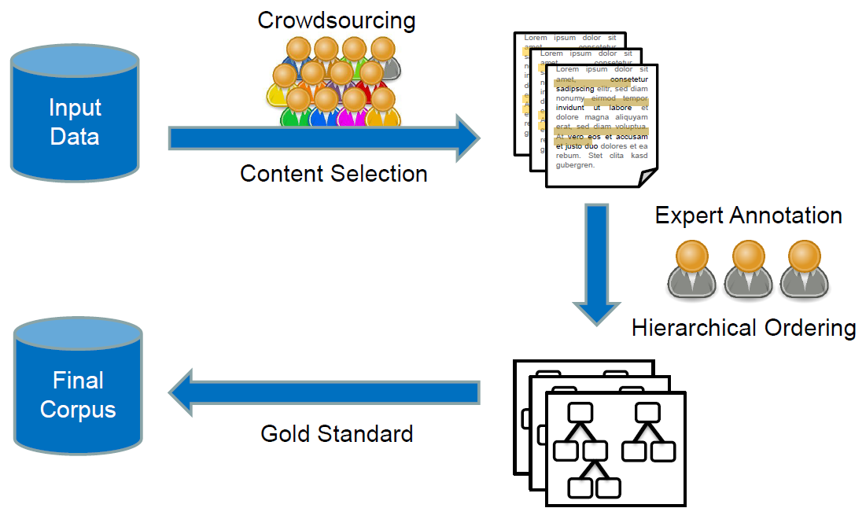
Hierarchical Approach
Situation
Task
Action
Result

Slide 7
Action

Slide 8
Step 1 | Content Selection Data Analysis
Situation
Task
Action
Result
Nugget ratios – Approximately 14% of all sentences per topic were nuggets
Nugget structure – About 82% of them were whole sentences
No words, that occur primarily in nuggets or non nuggets

Slide 9
Step 1 | Content Selection General Idea
Situation
Task
Action
Result
Approach: Learn a classifier to recognize nuggets
Use binary labeled training data from all 10 given topics
They now have 300 Associate Offices in 25 countries. 0
ATTEND takes about 30-60 days to become effective. 1
Get up early in the morning. 0
…
Labeled Data
Diet is often part of the problem. 1
…

Slide 10
Step 1 | Content Selection Approaches
Situation
Task
Action
Result
FastText Classifier
Naive Bayes
Fully Connected Neural Network
Convolutional Neural Network

Slide 11
Step 1 | Content Selection Results
Situation
Task
Action
Result
FastText Classifier - Bad
Naive Bayes - Bad
Fully Connected Neural Network - Bad
Convolutional Neural Network - Okay

Slide 12
Step 1 | Content Selection Convolutional Neural Network – Preprocessing
Situation
Task
Action
Result
Preprocess with gensim simple preprocess Allow only sentences between 5 and 50 words, pad them to 50 words
„I don‘t know. U.S. History II Attendance and tardies! All School Assemblies“ – good to read?
Negative Example
I don't know.
U.S. History II
Attendance and tardies!
All-School Assemblies

Slide 13
Step 1 | Content Selection Convolutional Neural Network – Architecture
Situation
Task
Action
Result
Input sentences as average word embedding (Bag of Words) -
300 embedding dimensions
Random Search with early stopping to find good Parameters
Criteria:
Recall > 0.05 Precision as high as possible
Data split into 3 sets: Training, Development, Testing
Implementation with Keras. Computation on Lichtenberg Cluster

Slide 14
Step 1 | Content Selection Convolutional Neural Network – Architecture
Situation
Task
Action
Result
Parametername | Possible Range | Final Params
Batch size | [120, 180] | 150
Number of convolutional layers | [1, 2] | 2
Filter sizes per layer | [4, 7] | 6, 6
Number of filters per layer | [30, 60] | 47, 42
Optimizer | [adam, sgd, adagrad] | Adagrad

Slide 15
Step 1 | Content Selection Convolutional Neural Network – Results
Situation
Task
Action
Result
Precision = 52%
Recall = 5.9%
Instead of using all predicted data, we used the 30 sentences with the highest nugget probability score
[Using tf-idf weighting of words lead to terrible results] – woanders hinschieben

Slide 16
Step 2 | creating hierachie generate hierachies from nuggets
Situation
Task
Action
Result
aim: insert nuggets into bubbles → build tree
used: compare two nuggets
if new bubble then use which function to determine the right bubble or create new
else insert in existing bubble
prelimitaries:
handle nuggets, remove stops and stem

Slide 17
Step 2 | creating hierachie insert function
Situation
Task
Action
Result
initial situation
new nugget
UP
INSERT
DOWN

Slide 18
Step 2 | creating hierachie compare and which function
Situation
Task
Action
Result
which()
use nltk_path_similarity to choose subtree
index of subtree
compare()
compare TF-IDF with
return similar (INSERT), general (UP), or specific (DOWN)

Slide 19
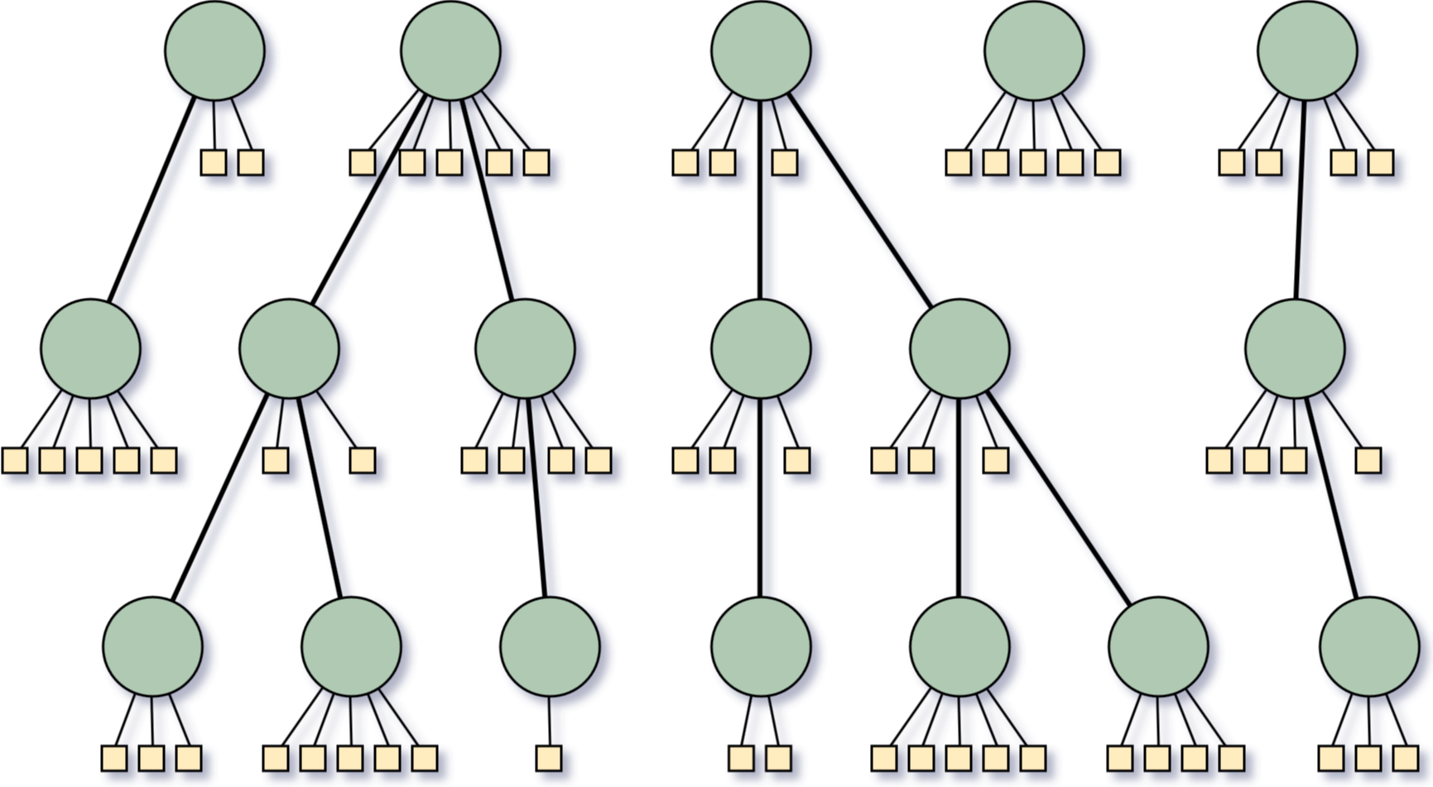
Step 3 | Creating summaries from hierarchies _
Situation
Task
Action
Result

Slide 20
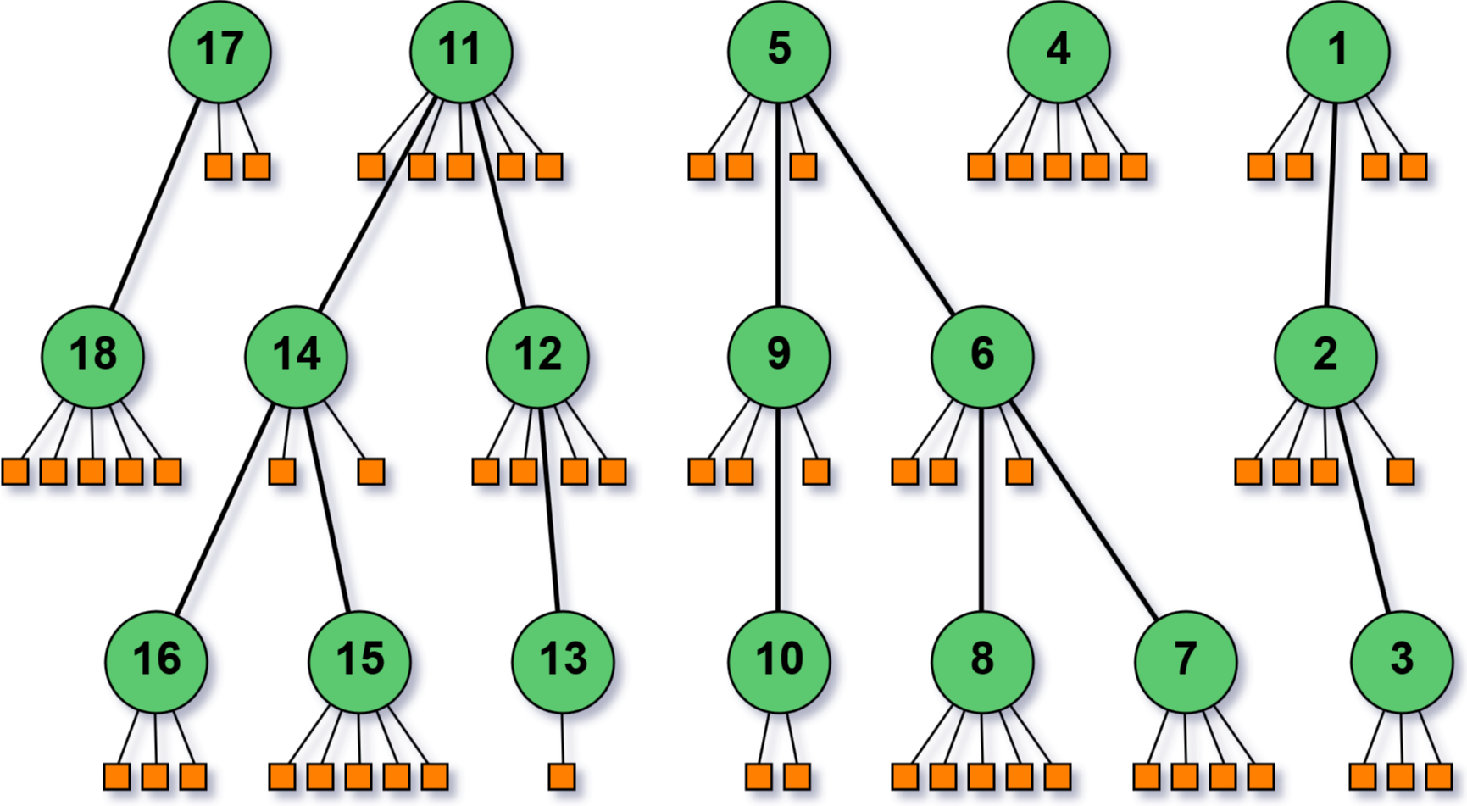
Step 3 | Creating summaries from hierarchies _
Situation
Task
Action
Result
first approach: Iterate in depth-first search order over the nuggets

Slide 21
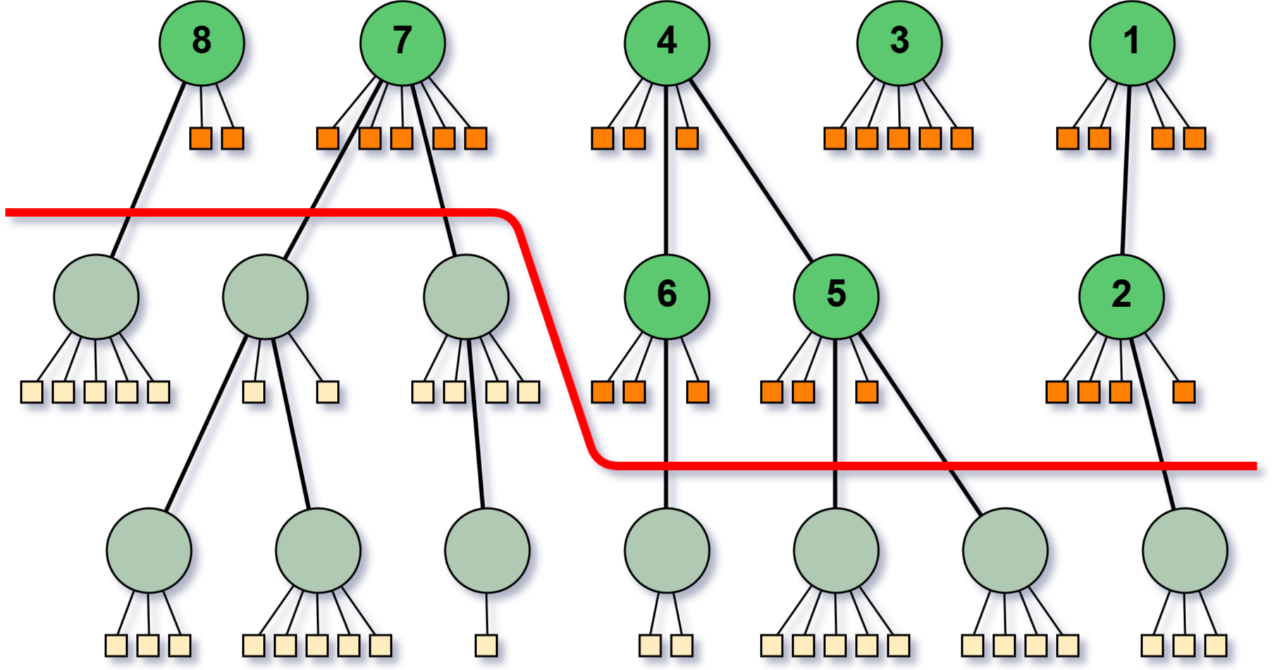
Step 3 | Creating summaries from hierarchies _
Situation
Task
Action
Result
cut layers off to get shorter summaries

Slide 22
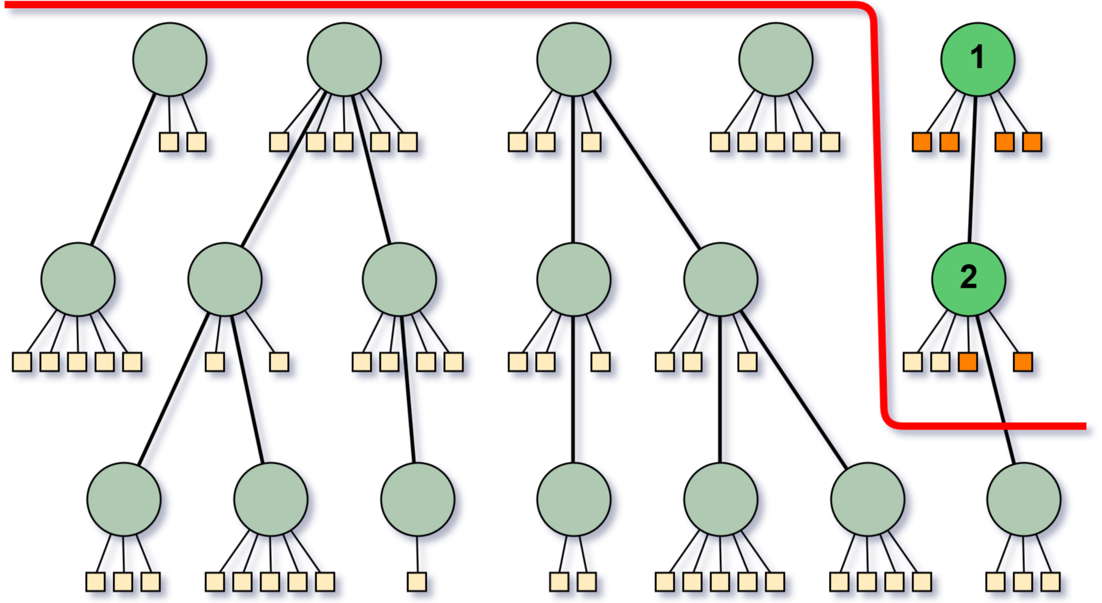
Step 3 | Creating summaries from hierarchies _
Situation
Task
Action
Result
problem when summaries are very short

Slide 23
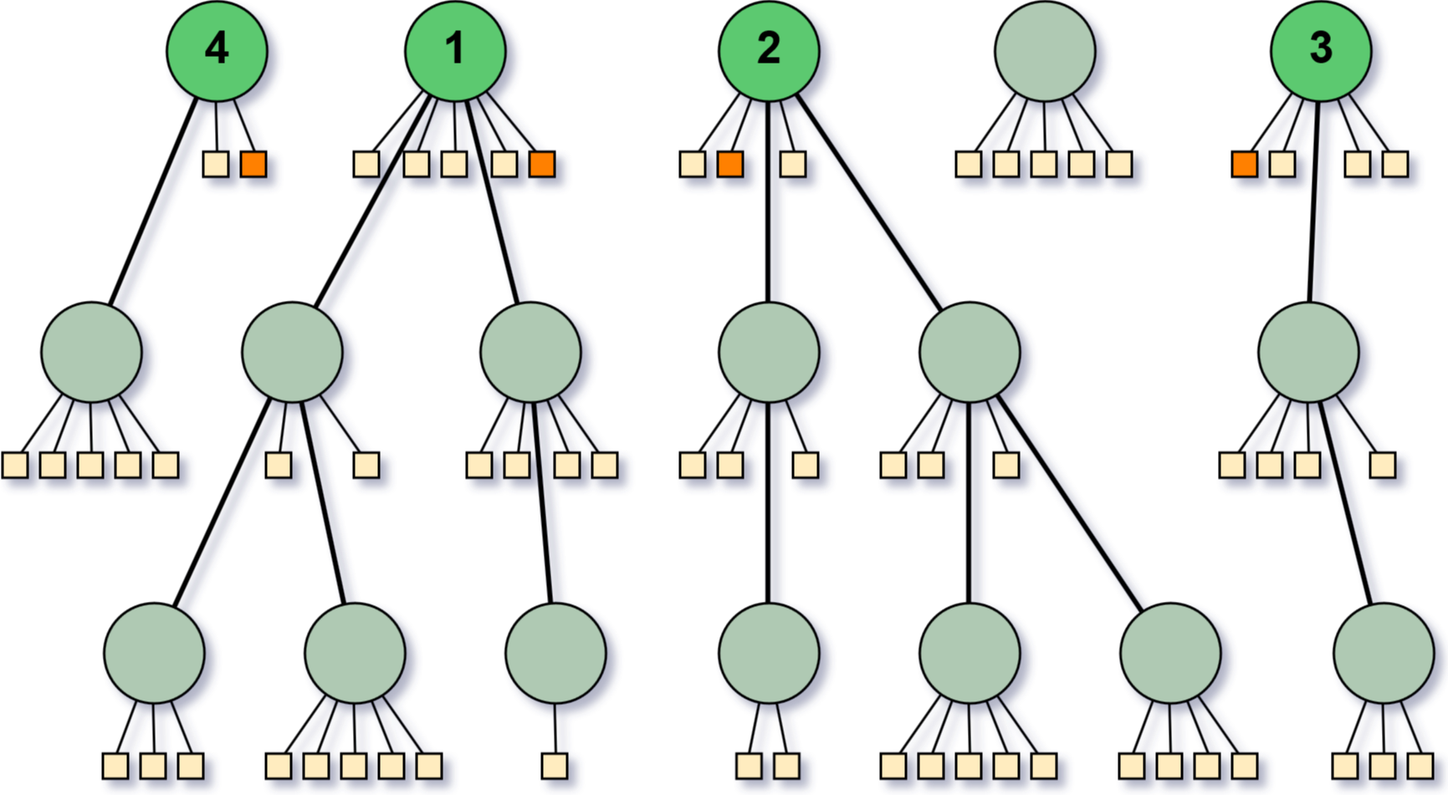
Step 3 | Creating summaries from hierarchies _
Situation
Task
Action
Result
select shortest sentences from root bubbles of the largest trees

Slide 24
Step 3 | Creating summaries from hierarchies _
Situation
Task
Action
Result
Baseline Text
Tool
Summary

Slide 25
Step 3 | Creating summaries from hierarchies _
Situation
Task
Action
Result
Gensim Summarizer
Implements variation of TextRank algorithm
Did not work well at all!
Baseline Text
Tool
Summary

Slide 26
Step 3 | Creating summaries from hierarchies _
Situation
Task
Action
Result
Sumy summariezers
Implementations of KL divergence, LexRank, LSA, Luhn algorithm, TextRank, …
Some produced barely acceptable output
Baseline Text
Tool
Summary
Notes:
Luhn: um so mehr wichtige Wörter in einem Satz, desto wichtiger für Zusammenfassung

Slide 27
Step 3 | Creating summaries from hierarchies _
Situation
Task
Action
Result
Summa summarizer
Also implementation of TextRank…
But with optimized similarity funktion
Worked really well for many topics
Baseline Text
Tool
Summary
Notes:
Original TextRank calculates similarity between sentences based on common words
plus divided by length -> no promotion of long sentences
Optimization: similarity by BM25

Slide 28
Step 3 | Creating summaries from hierarchies _
Situation
Task
Action
Result
Problem
Implementations mostly based on word count, sentence count or ratios
Never on character count

Slide 29
Step 3 | Creating summaries from hierarchies _
Situation
Task
Action
Result
Solution
Set word count so that approximately 600 characters are reached
Cut those sentences leading to more than 600
Adding sentences from hirarchy starting from the top level bubbles
make sure there are no duplicates
Notes:
Would have maybe been better to search for the bubble containing the last sentence in hirarchy and start adding sentences from there for more concurrency

Slide 30
Step 3 | Creating summaries from hierarchies _
Situation
Task
Action
Result
Observation that there are many definition sentences!
„ADHD is a brain-based disorder where the chemistry of the brain (neurotransmitters) is not functioning as it should.„
Extract
Add as first
sentence

Slide 31
Result

Slide 32
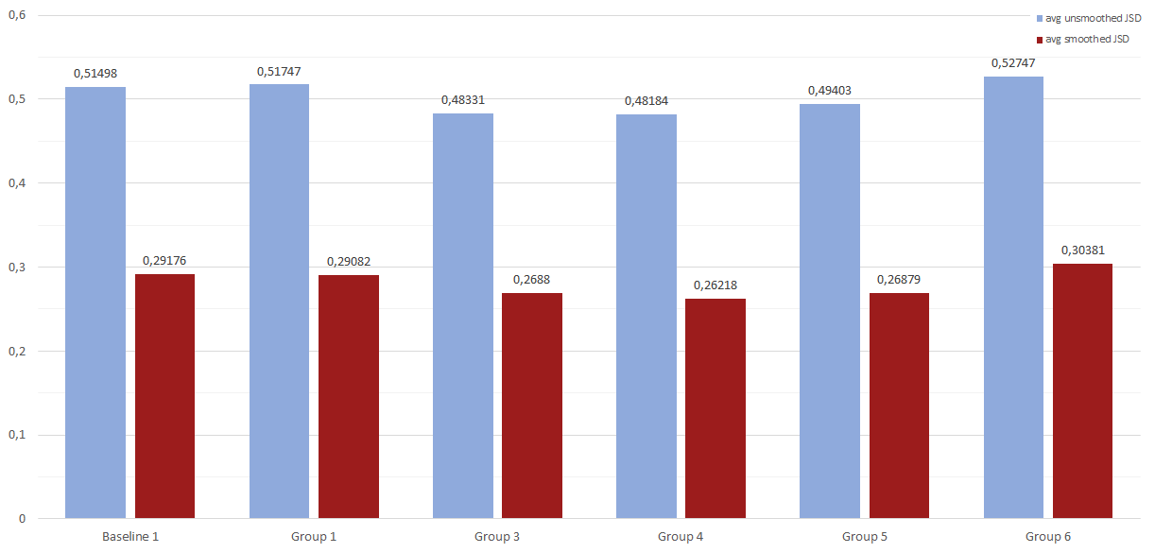
Evaluation Comparison with JSD
Situation
Task
Action
Result

Slide 33
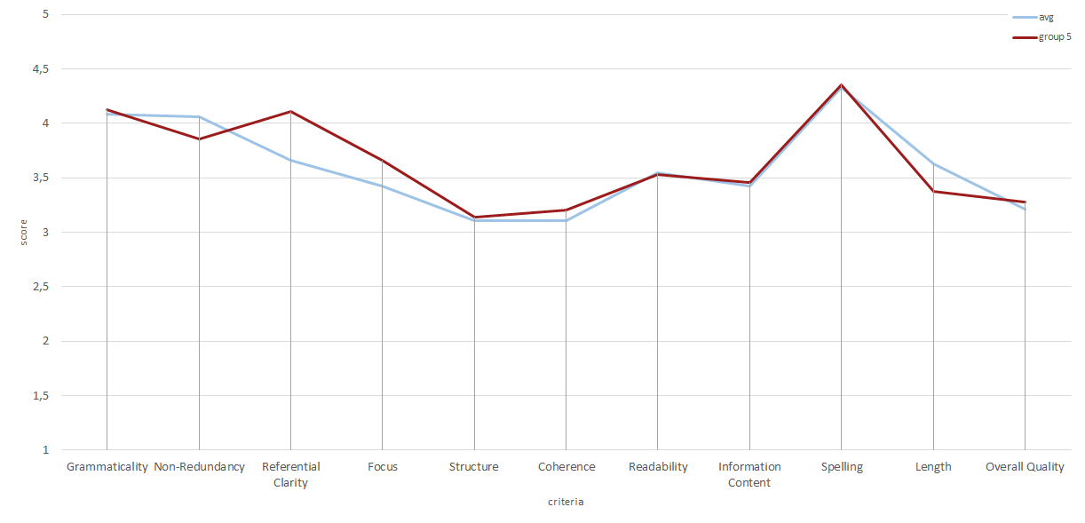
Evaluation scores per criteria
Situation
Task
Action
Result

Slide 34
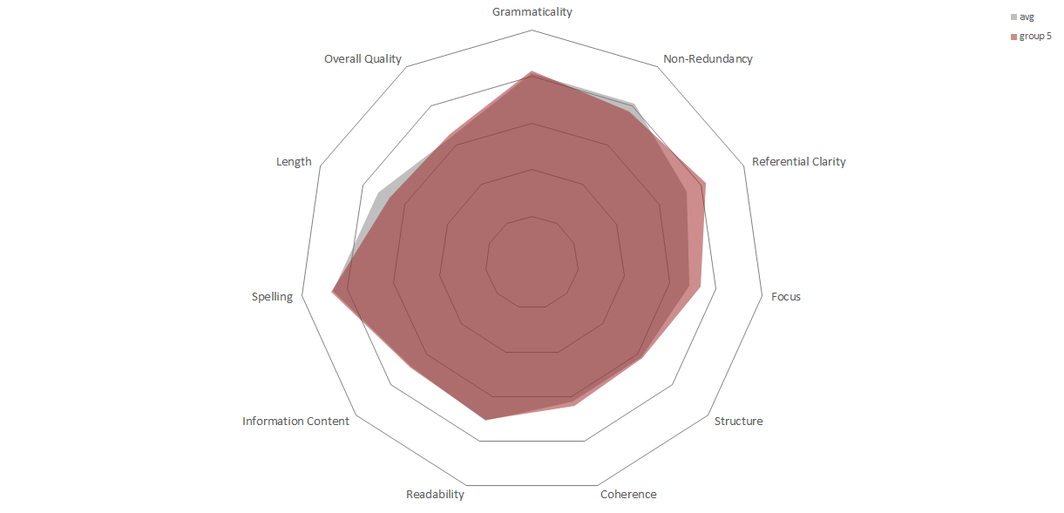
Evaluation scores per criteria
Situation
Task
Action
Result

Slide 35
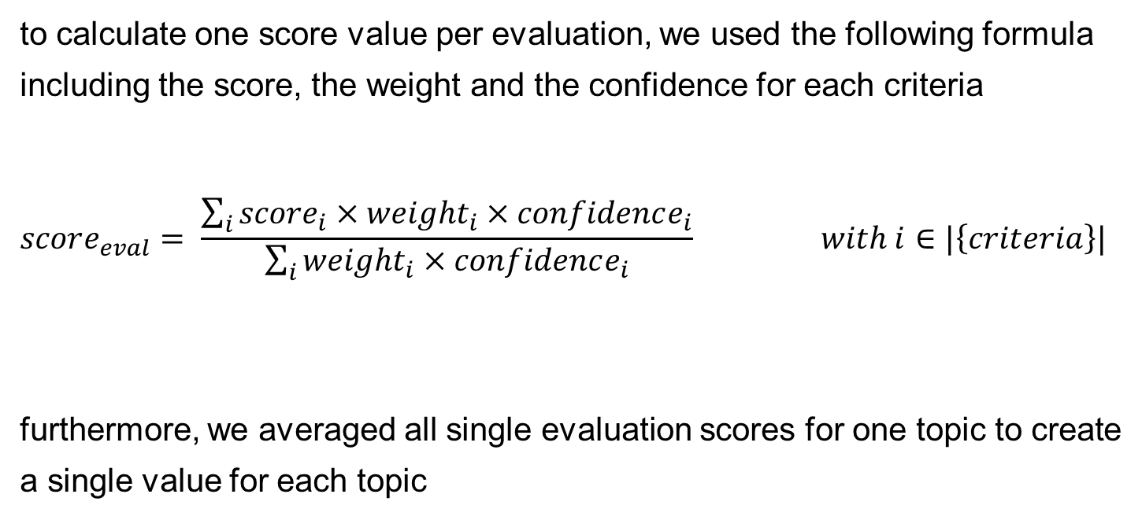
Evaluation score calculation
to calculate one score value per evaluation, we used the following formula including the score, the weight and the confidence for each criteria
$$score_{eval}= \frac{\sum_{i}{{score}_{i}×weight_{i}×confidence_{i}}}{\sum_{i}{weight_{i}×confidence_{i}}} with i∈|\left\{criteria\right\}|$$
furthermore, we averaged all single evaluation scores for one topic to create a single value for each topic

Slide 36
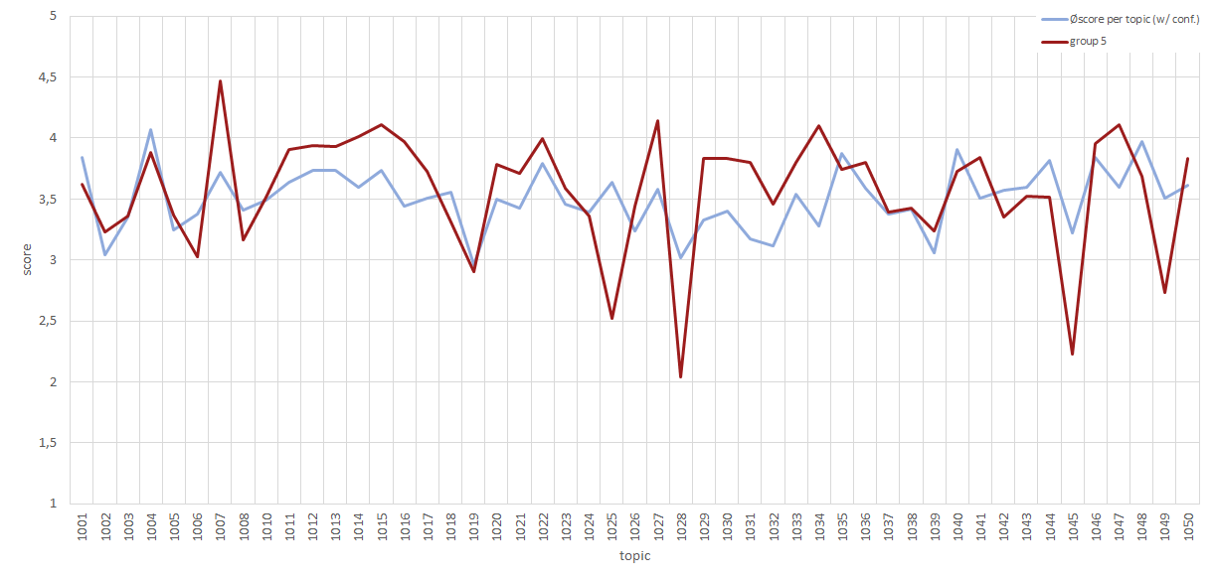
Evaluation calculated score per topic
Situation
Task
Action
Result

Slide 37
Evaluation
Situation
Task
Action
Result
Our worst summary (Topic 1028):
The parents are exhibiting some serious problems as well, such as drug abuse, alcohol abuse, criminal involvement, and domestic violence.
teen discipline, teen boot camp, alcohol abuse, Binge Drinking, Substance Abuse, Addiction, bad behavior, boot camp, children respect, parenting tips, aggressive behavior, James Lehman, Total Transformation Individuals suffering from mental health disorders may use alcohol and illicit drugs to decrease or mitigate their psychological distress 16 .

Slide 38
Evaluation
Situation
Task
Action
Result
Our best summary (Topic 1007):
Fears and Phobias can be resolved with hypnosis and hypnotherapy Hypnotherapy is an ideal option because it is safe, effective, and non-invasive.
If a parent is afraid of spiders then a child can learn that fear and it could develop into a phobia.
Hypnotherapy is effective at helping you to overcome your fear by treating the anxiety caused by the trigger, and by re-training the mind to remember the original trigger in a way that does not create anxiety.
Medication can be very effective in treating phobias, especially social phobia and agoraphobia.

Slide 39
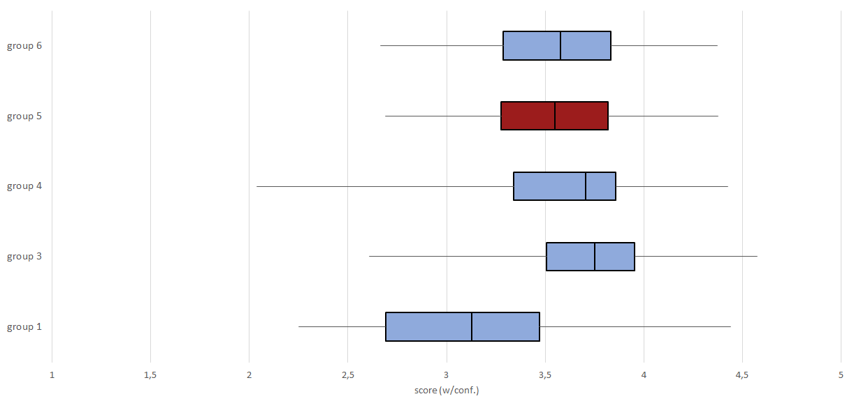
Evaluation statistical score values over all topics per group
Situation
Task
Action
Result

Slide 40
Evaluation
Situation
Task
Action
Result
each of our summaries were evaluated by at least 4 raters

Slide 41
Thank You for your attention

